Slide 1
Getting SPICY with SQL
A crash course on SQL by KEVIN ZHANG
Notes:
- thank MTA
- thank everyone for coming
- alliteration

Slide 2
A LITTLE BIT ABOUT ME…
Kevin Zhang:
4th year Software Engineering specialist
CSCB20 teaching assistant
Systems Developer at Municipal Property Assessment Corporation
Kung Fu master; personally trained Jaden Smith
Had a small role in Crazy Rich Asians
Notes:
- TEDx comment
- 4th year at UTSC
- TA
- MPAC
- jackie chan
- crazy rich asians

Slide 3
TODAY’S AGENDA
Introduction to SQL
A brief history lesson and its practical uses
Tables and the relational database model
The bread and butter
SELECT, INSERT, CREATE, DROP, DELETE, and UPDATE statements
JOIN statements (INNER JOIN, LEFT JOIN, …)
Additional topics
GROUP BY, HAVING, UNION, and views
A (cool?) project
You won’t BELIEVE what happens next, don’t click away!
If we have some time leftover…
SQL injection
Notes:
- try not to be too boring doing dumb examples
- we'll be doing a lot of dumb examples in the beginning in order to learn how things work
- the project will be a cooler showcase of what you're going to learn
- what people actually use in real life

Slide 4
BEFORE WE GET STARTED…
What this workshop is…
What this workshop is not…
A presentation to get you familiarized with SQL
A place for you to understand what SQL is and the things it does
You’ll gain some ideas of how to use SQL and be a step ahead of those who don’t
A course to study SQL
A workshop is not a replacement for a course on relational databases
We skip over a lot of more advanced topics like relational algebra, ER diagrams, the E-R model…
Many great courses at UTSC on these topics
CSCC43
CSCC09
CSCB20
Notes:
- differences between CSCC43
- ER diagrams
- much more in depth with queries
- much more difficult practice problems
- just breaking the ice...
- CSCB20 recommended for beginners
- get your feet in the water
- don't need to be in comp sci to be in it

Slide 5
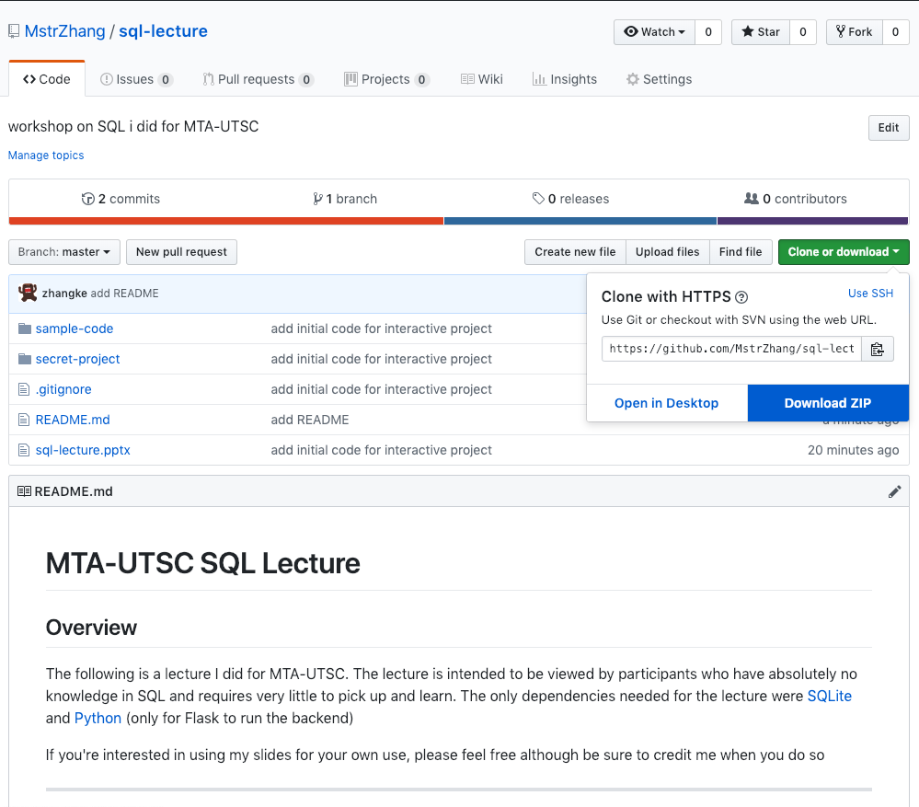
FOLLOWING ALONG?
Starter code:
Head to https://github.com/mstrzhang/sql-lecture to download slides and starter code to follow along
Click on Clone or Download and in the pop-up select the Download ZIP option
SQLite:
Head to https://sqlitebrowser.org/ to download the SQLite browser
Follow the instructions for installation on whatever operating system you’re running
Python:
You only need this if you’re following along with the “secret project”
We will be using Python 3.7
Notes:
- talk about SQLite
- flavours of SQL
- used heavily in mobile development
- easy to use
- only needs a file to setup
- regular databases are cumbersome to setup
- talk about Python
- used in some places for web development
- talk about Flask

Slide 6
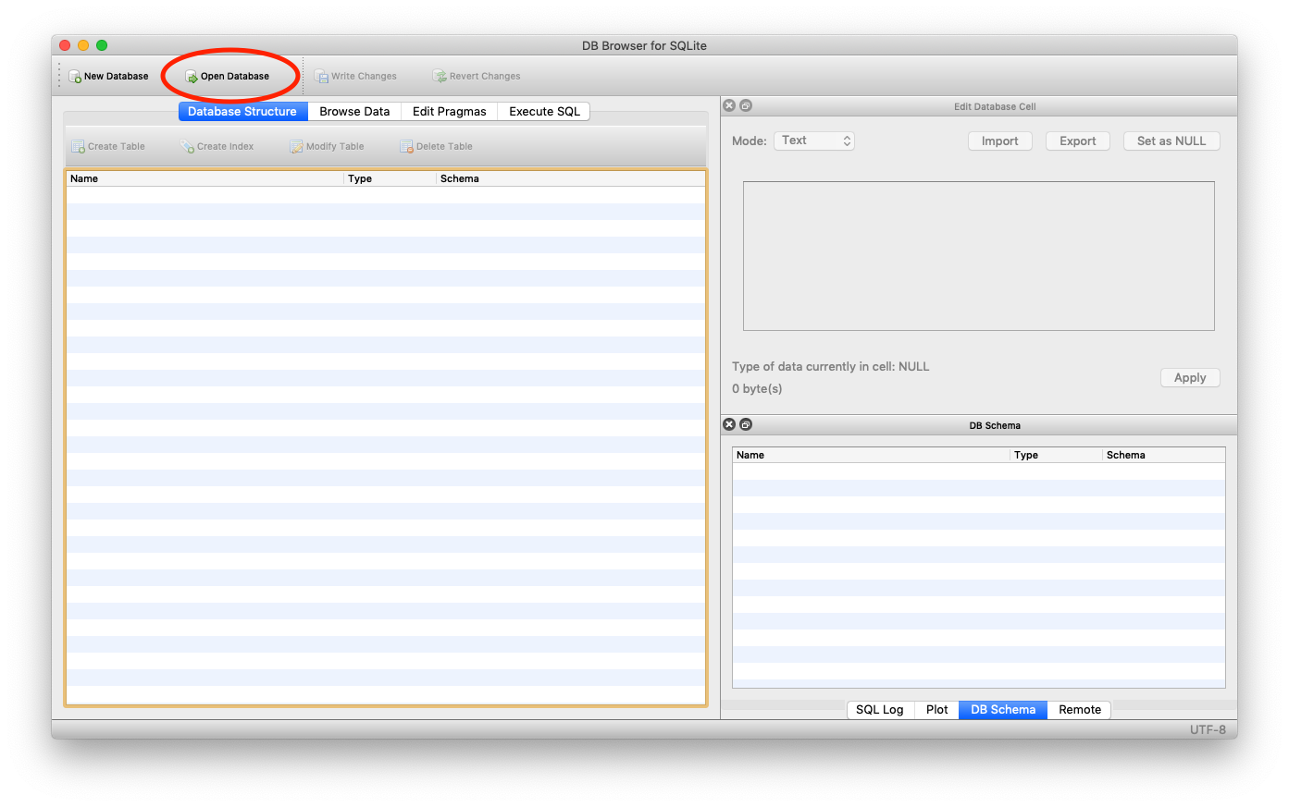
SETTING UP THE DATABASE
Open up the DB Browser for SQLite
Click in the top left corner on Open Database
Navigate to the database file database.db to open the file
Click Browse Data to see the contents of the tables
Notes:
- comment on how you don't normally do this in practice
- talk about command line program (maybe even show it)
- talk about why we use something like this
PHILLY D SAY THE LINE

Slide 7
LET’S JUMP INTO IT…

Slide 8
A QUICK (but hopefully not too boring) HISTORY OF SQL
In the past, there were files
Crummy way of storing and retrieving data
Edgar F. Codd creates the relational model
Computer scientists from IBM create the first version of SQL that will become what we use today
And the rest is history…
Notes:
- talk about how bad it was to access files in the past
- reading and writing from file
- keeping all files up to date and in sync with one another
- editing the middle of a file
- writing code to read the file

Slide 9

WHAT THE HECK IS SQL?
WITH T AS (SELECT TOP 50 * FROM springfield ORDER BY id DESC) DELETE FROM T
SQL = Structured Query Language
A simple and organized way of inserting and retrieving information from a database
Common queries:
SELECT
INSERT
UPDATE
DELETE
CREATE
DROP
Notes:
SQL advantages:
- easy way to get data
- easy way to put data in
- consistent
- less time needed to code reading and writing to files
- much easier to learn

Slide 10
WHY SHOULD I LEARN THIS MUMBO JUMBO?
The average SQL Developer in the United States makes $84,245 per year
Incredibly crucial and important job in many tech companies
One of the most sought-after skills by hiring employers
Currently hundreds of thousands of open positions on Indeed.com
Essential to know for any sort of serious application development
Tons of potential jobs:
Project managers, Data analysts, Data scientists, Data engineers, …
Notes:
$84,245 freedom dollars = $111,538.27 CAD
- other jobs make even more
- big data analysts
- stats people
companies usually have a person who deals with SQL:
- one guy who knows all of the tables

Slide 11

WHAT CAN YOU EVEN DO WITH SQL?
Notes:
show the search engine project

Slide 12
THE SELECT STATEMENT
Notes:
YEET THAT WHEAT SAY IT

Slide 13
RELATIONS
SQL is made up of tables called relations
Data is stored in relations in tuples called records
Each record can contain many components called attributes
We access the data in the relations using queries
We refer to a collection of relations as a schema
Think of SQL like an Excel file…
ID | firstName | lastName | gpa | grade
1 | Alice | Allison | 3.7 | 83
2 | Bob | Boberto | 0 | 36
3 | Chad | Chadwick | 2.7 | 72
4 | Kevin | Zhang | 4.0 | 115
SELECT * FROM students WHERE id = 2;
SELECT lastName FROM students;
Notes:
show the query that returns a record
show the query that returns an attribute
like an excel file:
- the database is like the file
- the schema is like the sheets
- the tables are like tables in the sheets
- queries are sort of like excel functions

Slide 14
THE SELECT STATEMENT
The SELECT statement pulls records from a table
The most commonly used query in SQL
The table you wish to select from is specified using the FROM clause
You can filter the result using the WHERE clause
The basic syntax of the SELECT statement
SELECT col1, col2, … FROM table
Notes:
no LIMIT example in live coding (so show that too)

Slide 15
ORDER BY
By default, the records returned come out in an unspecified order
Sometimes you want to control the order of which the the records are returned…
Two keywords for ordering:
ASC – ascending order
DESC – descending order
How to use ORDER BY
SELECT col1, col2, … FROM table ORDER BY col1 [ASC, DESC], col2 [ASC, DESC], …;

Slide 16
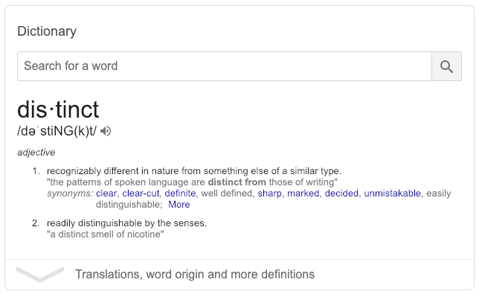
DISTINCT
When given this keyword, the SELECT clause omits duplicated rows in a set
Useful for when you have overlapping conditions but you only want 1 result
How to use DISTINCT
SELECT DISTINCT col1, col2, … FROM table;
Notes:
ask to guess what DISTINCT means
comment on how it's easy to read and understand

Slide 17
THE WHERE CLAUSE
Currently, we’ve been selecting everything from given column(s)
The WHERE clause allows us to filter out the data returned by the query
We do this by doing comparisons
The monstrous SELECT statement…
SELECT col1, col2, … FROM table ORDER BY col1 [ASC, DESC], col2 [ASC, DESC], … WHERE condition;

Slide 18
COMPARISONS
OPERATOR | MEANING
ALL | TRUE if all expressions are TRUE
AND | TRUE if both expressions are TRUE
ANY | TRUE if any expressions are TRUE
BETWEEN | TRUE if value is within some given range
EXISTS | TRUE if subquery returns any rows
IN | TRUE if value is in a list of values
LIKE | TRUE if value matches some pattern
NOT | Reverses the value of TRUE/FALSE
OR | TRUE if one of expressions is TRUE
OPERATOR | MEANING
= | Equals
<> or != | Not equals
< | Less than
> | Greater than
<= | Less than or equal to
>= | Greater than or equal to

Slide 19
YOU NOW KNOW THE ABSOLUTE BASICS OF SQL
(you right now circa 2019)
Notes:
selecting is all you need
low expectation job interviews

Slide 20
JOINS
Notes:
a little more complicated
kind of daunting at first but pretty easy to follow
the power of relational databases
- files are difficult to sync together
- can have more complicated structures

Slide 21
SQL JOIN
A JOIN operation connects tables together
Typically, you’ll have more than one table in your database
These tables need to interact with one another to get data that the other table needs
Stringing tables together helps us create complex relations
Tables can only be joined if they share a relationship
OrderID | CustomerID | Date | Item | Quantity
10308 | 1 | 2019-02-07 | Toothpaste | 981532
10309 | 420 | 2019-01-30 | Pencil | 30
10310 | 69 | 2018-11-15 | Printer | 1
CustomerID | FirstName | LastName | Country
1 | Kevin | Zhang | Canada
2 | Alice | Allison | USA
3 | Bob | Boberto | Japan
Notes:
that's a lot of toothpaste

Slide 22
PRIMARY AND FOREIGN KEYS
We denote special attributes in a relation as keys
A key is a unique attribute of a relation that can uniquely identify a given row
There are two types of keys
Primary key – a unique attribute in the table
Foreign key – the primary key of another table
Tables are joined on the shared relationship of these keys
OrderID | CustomerID | Date | Item | Quantity
10308 | 1 | 2019-02-07 | Toothpaste | 981532
10309 | 420 | 2019-01-30 | Pencil | 30
10310 | 69 | 2018-11-15 | Printer | 1
CustomerID | FirstName | LastName | Country
1 | Kevin | Zhang | Canada
2 | Alice | Allison | USA
3 | Bob | Boberto | Japan
Notes:
PRIMARY KEY can also consist of multiple attributes
- primary key ensures that the record can be uniquely identified

Slide 23
JOIN TYPES
Notes:
won't be teaching FULL OUTER JOIN because it is not possible to do in SQLite (needs a workaround and not used much in practice)
won't be teaching RIGHT JOIN because it's the same as LEFT JOIN and you can't do it in SQLite

Slide 24

INNER JOIN
The INNER JOIN is the simplest join you can do in SQL
Selects records that have matching values in both tables
An INNER JOIN is a type of “inner join”
Changes the number of rows returned
Reduces number or stays the same
A NATURAL JOIN is a special INNER JOIN
SQLite looks for the columns that are named the same for the join condition
INNER JOIN syntax:
SELECT col1, col2, … FROM table1 INNER JOIN table2 ON table1.col = table2.col;
(the word INNER is optional)

Slide 25
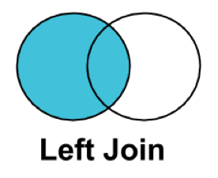
LEFT JOIN
The LEFT JOIN picks up all the contents of the left table and whatever matching records there are in the right table
LEFT JOIN is a type of outer join
Outer joins “pick up” additional rows if possible
Don’t change the number of rows returned but may add extras
A RIGHT JOIN is just a LEFT JOIN but considering the opposite table (however SQLite doesn’t support this clause)
LEFT JOIN syntax
SELECT col1, col2, … FROM table1 INNER JOIN table2 ON table1.col = table2.col;

Slide 26
CROSS JOIN
CROSS JOIN produces a set that has the number of rows in the first table multiplied by the number of rows in the second table
In math, this is called a Cartesian join
The CROSS JOIN is a potentially dangerous operation
Has the potential of creating a BIGLY table
In practice, this join is not very useful
A JOIN without the ON condition will produce a CROSS JOIN

Slide 27
SELF JOIN
Sometimes a table has no friends and no one to join with
SOLUTION: JOIN with yourself!
When would you ever do this?
Sometimes you have a table that references attributes in its own table
There’s an issue though
You can’t reference the same table more than once in a query
We’ll use something called an alias to “rename” the duplicate
ID | FirstName | LastName | Title | ReportsTo
1 | Michael | Scott | Regional Manager | NULL
2 | Dwight | Schrute | Assistant to the Regional Manager | 1
3 | Jim | Halpert | Salesman | 1
4 | Pam | Beesly | Receptionist | 1

Slide 28
THAT’S ENOUGH JOINS FOR TODAY…
N A N I ???
You understand SELECT and JOIN, but we do not grant you the rank of SQL master

Slide 29
INTERMEDIATE SQL
Notes:
not really intermediate:
- things that don't fit in from before
- there's a lot of crazy stuff you can do that i won't teach
more refined ways of selecting

Slide 30
GROUP BY
GROUP BY is an optional clause in the SELECT statement
“Groups” a summary of rows by values of one or more columns
The GROUP BY clause is used for aggregate functions
Aggregate function – takes in multiple rows and returns a single value
Examples: COUNT(), MIN(), MAX(), AVERAGE(), SUM()
GROUP BY syntax:
SELECT col1, col2, … FROM table WHERE condition GROUP BY col1, col2, …;

Slide 31
HAVING
HAVING is similar to WHERE however it works on aggregates
WHERE filters rows from a result set
HAVING filters values from an aggregate
The two clauses cannot be interchanged
Using a WHERE in place of HAVING does not work!
This is a common error in exams :)
Using HAVING with GROUP BY
SELECT col1, col2, … FROM table WHERE condition GROUP BY col1, col2, … HAVING condition;
Notes:
comment on CSCC43 exams

Slide 32
UNION
UNION combines result sets together into a single result set
Useful if you have tables with similar data or need to combine similar data from multiple databases
Main conditions:
Number of columns must be the same
Columns must be of the same data type
UNION syntax:
query_1 UNION [ALL] query_2 UNION [ALL] …
(the optional ALL parameter will keep duplicate rows)

Slide 33
CASE
CASE is similar to an if-then-else structure in programming languages (or a switch statement)
If a certain condition is true, we run a given query
If another is true, we run that query instead and so on
CASE is useful for logic based queries
You want to query for something given one condition and for something else given another
CASE syntax
CASE expr WHEN cond1 THEN res1 WHEN cond2 THEN res2 … [ELSE res] END

Slide 34
SUBQUERIES
A subquery is a query inside of a query
Sometimes you want to query on a result set as opposed to an entire table
A result set is a table in itself and can be queried as if it were a table
Subqueries and joins usually accomplish similar things
When you would use one over the other comes down to performance
You would learn about this in a relational database course like CSCC43
A subquery can only be used in the SELECT, FROM, WHERE or JOIN clauses
An example subquery:
SELECT col1 FROM table1 WHERE col1 = (SELECT col1 FROM table2)

Slide 35
SELECT QUERIES ARE GONE!
Notes:
all of the basic stuff you need to know for SELECT
- still a lot more options and things that you can do
- a database course would test you much harder on these concepts

Slide 36
THE SECRET PROJECT…
Notes:
take a break here
perhaps lengthy if way too much time leftover

Slide 37
DAS POKËDÅX
From the mildly popular video game and show DIGIMON
A culmination of all of the skills you’ve learned today
Optional if you want to follow along
Requires the use of Python
A lot of web development so if you’re not comfortable with that I’d suggest you just watch
Notes:
joke on the name
from this point, create the tables with the next slides in the project

Slide 38
TABLES CAN BE WHATEVER I WANT…

Slide 39
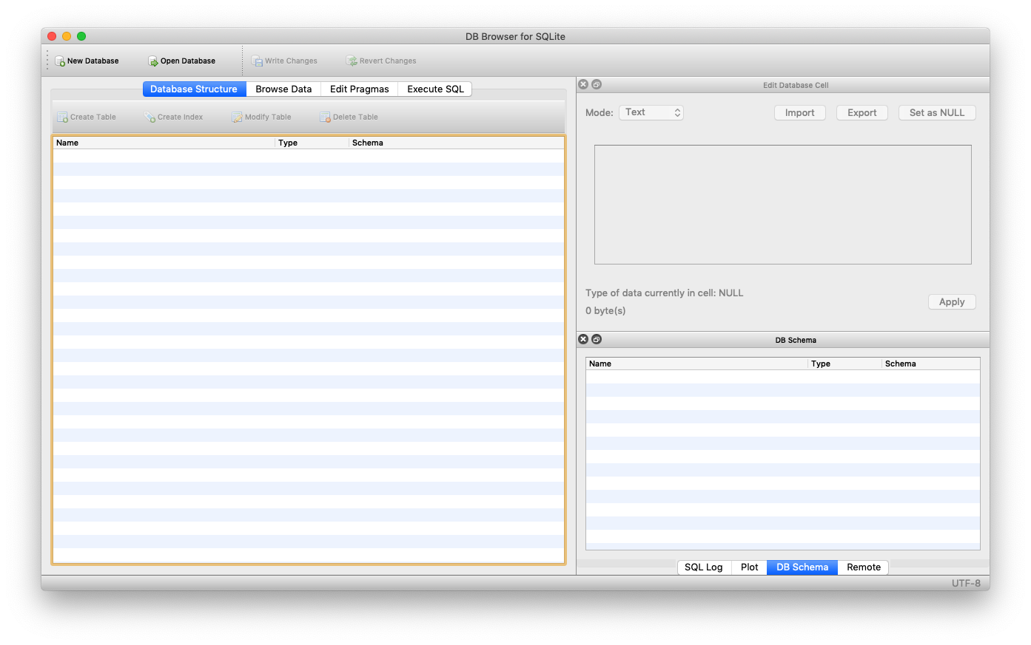
CREATE A NEW DATABASE

Slide 40
CREATE TABLE
Like SELECT, we can create tables using queries
Tables are created in a database
A collection of tables together is called a schema
When we create a table, we can assign the columns, their datatypes, any constraints, and any primary/foreign key pairs
CREATE TABLE syntax:
CREATE TABLE [IF EXISTS] table ( col1 datatype [key/const], col2 datatype [key/const], … )

Slide 41
INSERT
The INSERT statement allows us to insert data into a given table
You can insert either single records or multiple records
The records you add must conform to the constraints you add otherwise they will be rejected
INSERT syntax:
INSERT INTO table ( col1, col2, …) VALUES (val1, val2, …), (val2, val2, …), …;

Slide 42
UPDATE
The UPDATE query modifies pre-existing records in a table
In practice, the UPDATE query is used sparingly
It is not good practice to manually edit data
With the exception of tables like lookups (which may change over time)
UPDATE syntax:
UPDATE table SET col1 = val1, col2 = val2, … WHERE condition;
Notes:
updating dynamic data is bad

Slide 43
DELETE
DELETE removes a given record from a table
The DELETE query is used even more sparingly than UPDATE
It is generally frowned upon to remove values from a database
It is better to keep records but set them to be invisible to the frontend
As you may have guessed, the DELETE query is dangerous
DELETE syntax:
DELETE FROM table WHERE condition;
Notes:
you may want a record again in the future

Slide 44
ALTER
ALTER modifies a table
The word “modify” is very loose
Things that you can modify:
The name of a table
The columns in a table
Other advanced things:
Indices
Triggers
Transactions
…
ALTER syntax:
ALTER TABLE table RENAME TO new_table;
ALTER TABLE table ADD COLUMN definition;
Notes:
alter is a very powerful command but we only use it for two options

Slide 45
DROP
DROP deletes an entire table
Usually used in the beginning of schema creation scripts to clean up the database beforehand
DROP is very dangerous
When a table is dropped, its records cannot be recovered!
Usually in practice, DROP is used carefully through a transaction
Sort of like a “test run” before it actually applies on the data
DROP syntax:
DROP table;
(use this move on your boss if you want to lose your job)
Notes:
story about how i dropped prod database

Slide 46
You
People who don’t know SQL
Notes:
you know everything you need to know for a basic interview
- still a lot to learn but you have all the basics here

Slide 47
ONE LAST THING…
Notes:
unghh

Slide 48
SQL INJECTION
SQL injection occurs when a malicious user provides an input that causes your program to unwittingly run SQL code
I intentionally made the Pokédex vulnerable to SQL injection!
In the past, SQL injection was one of the most common web attacks
Nowadays, more people are aware of it so it occurs less often…
Notes:
website with lots of SQL injection attacks
https://codecurmudgeon.com/wp/sql-injection-hall-of-shame/

Slide 49
WHY IT HAPPENS?
Typically, a (bad) programmer will write code with unsanitary input
sql = “”“ SELECT * FROM pokemon WHERE id = {id} ”””.format(id=input_id)
Typically, this will not cause an issue however if the user is up to no good…

Slide 50
THE ATTACK
Instead of providing a valid input, the user provides an input that will close the intended query and allow them to add additional SQL code the program will run
Suppose id was equal to the following string:
“105; DROP TABLE pokemon;”
We would end up running the following query:
SELECT * FROM pokemon WHERE id = 105; DROP TABLE pokemon;
(see the problem?)

Slide 51
HACKERMAN
You aren’t limited to causing destruction with SQL injection. You can also reveal confidential information
sql = 'SELECT * FROM Users WHERE Name =”’ + uName + '" AND Pass ="' + uPass + ‘”’
Suppose the user input the following values:
uName = " OR ”1=1” uPass = " OR ”1=1”
The query ends up becoming:
SELECT * FROM Users WHERE Name ="" OR ”1=1" AND Pass ="" OR ”1=1”
(this is always TRUE and returns everything)

Slide 52
HOW DO YOUR PROTECT YOURSELF?
The number one strategy of protection is to sanitize your inputs
Always check the inputs that you get from the user
You should NEVER trust the user to be a trustworthy person
Always put quotations around ALL input
Most frameworks have a way of preventing this
It’s a MAJOR oopsie if you fall for this in 2019

Slide 53
THAT’S IT FOR ME

Slide 54

WANT MORE FROM ME?
INSTAGRAM:
https://instagram.com/mstr_zhang
LINKEDIN:
https://www.linkedin.com/in/mstrzhang/
GITHUB:
https://www.github.com/mstrzhang
WEBSITE:
https://www.mstrzhang.github.io
(perhaps catch me in my next film)
Notes:
thank everyone again
take questions for a while at the very end (probably will be a lot of time leftover)

